Slide 1
Practice 6 - CPUScheduler Simulator V3

Slide 2
CPUScheduler Simulator V3 - Source Code Description
Current code status (V3)
Multiprocessors are available
RM, EDF, FIFO are implemented
in Algorithm_RM.java
in Algorithm_EDF.java
in Algorithm_FIFO.java
(At least 1000, up to 100,000) Task sets are randomly generated with bimodal and exponential distributions
The number of task sets that can be generated is dependent on the number of considered distribution and seed numbers
The skeleton code for Deadline-based analysis (naïve version) is implemented
In Analysis.java
Graph generation code will not be included
I/O will not be considered

Slide 3
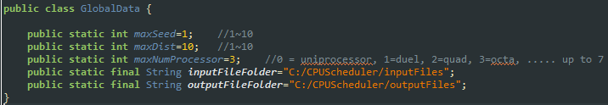
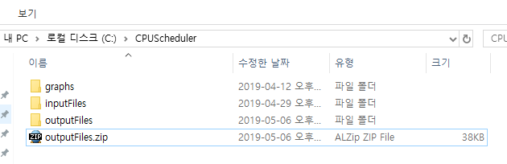
You should complete implementing Deadline-based analysis for any scheduling in CPUScheduler V3
Follow the following steps
There should be file folders for input & output files in your PC; modify GlobalData.java and create the corresponding folders
Download outputFiles.zip from E-learning site, and unzip the file to your outputfile folder

Slide 4


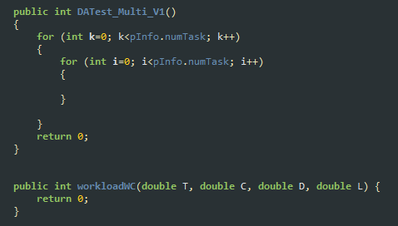
Create input files; run _Gen_Set.java
Complete Deadline-based analysis; modify Analysis.java

Slide 5
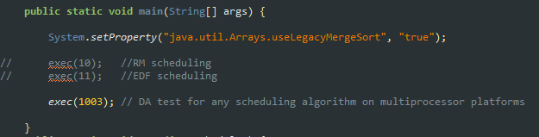
run _Exec_Set.java file; you don’t have to run for ’10’ and ‘11’

Slide 6
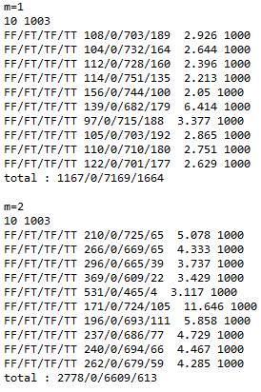
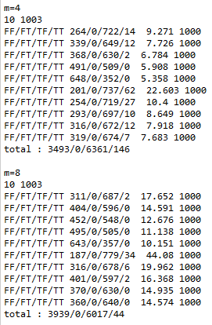
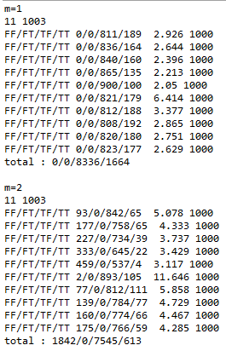
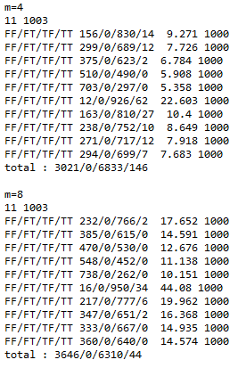
You see the following results by executing __ResultCompare.java

Slide 7
Schedulaiblity Analysis for Global Scheduling on Multiprocessor
Deadline-Based Analysis (DA analysis)
For any global preemptive scheduling (e.g., RM, EDF, etc.) on m identical multiprocessor
Underlying Idea
For each task τ_{κ}
check whether a job of τ_{κ} can complete its execution within D_{k} by calculating
I_{k}(D_{k}) = total interference suffered by task τ_{k} in interval of D_{k} and
the worst-case execution time C_{k}
τ_{k} is schedulable under any global scheduling if
C_{k}+I_{k}(D_{k}) ≤D_{k}

Slide 8

Schedulaiblity Analysis for Global Scheduling on Multiprocessor
Deadline-Based Analysis (DA analysis) – base idea
τ_{k} is schedulable under any global scheduling if
C_{k}+I_{k}(D_{k}) ≤D_{k}
execution of τ_{k}
execution of higher priority jobs
A job of τ_{k} is released here
$$\text{I}\text{k}\text{(}\text{Dk}\text{)}$$
m
t
t + D_{k}

Slide 9
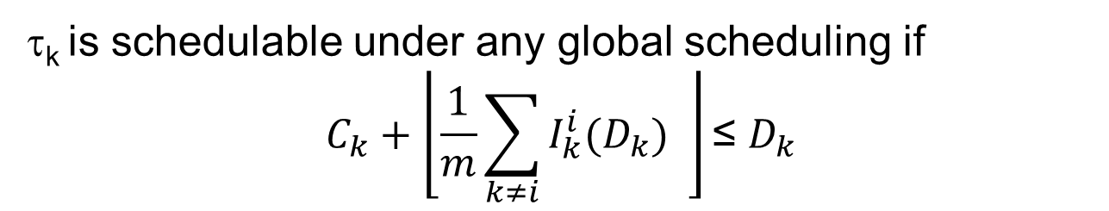
Schedulaiblity Analysis for Global Scheduling on Multiprocessor
Deadline-Based Analysis (DA analysis) – base idea
τ_{k} is schedulable under any global scheduling if
$$C_{k}+\left\lfloor \frac{1}{m}\sum_{k≠i}{I_{k}^{i}(D_{k})} \right\rfloor \text{≤} D_{k}$$
$I_{k}^{i}(D_{k})$= amount of execution of τ_{i} performed in D_{k}
A job of τ_{k} is released here
$$\text{I}\text{k}\text{(}\text{Dk}\text{)}$$
m
t
t + D_{k}

Slide 10
Schedulaiblity Analysis for Global Scheduling on Multiprocessor
Deadline-Based Analysis (DA analysis) – base idea
τ_{k} is schedulable under any global scheduling if
$$C_{k}+\left\lfloor \frac{1}{m}\sum_{k≠i}{I_{k}^{i}(D_{k})} \right\rfloor \text{≤} D_{k}$$
$I_{k}^{i}(D_{k})$= amount of execution of τ_{i} performed in D_{k}
A job of τ_{k} is released here
$$\text{I}\text{k}\text{(}\text{Dk}\text{)}$$
m
t
t + D_{k}

Slide 11
Schedulaiblity Analysis for Global Scheduling on Multiprocessor
The worst-case release pattern of τ_{i} maximizing $I_{k}^{i}\left(D_{k}\right)$
job release/deadline
execution
D_{k}
T_{i}
C_{i}
D_{i}

Slide 12
Schedulaiblity Analysis for Global Scheduling on Multiprocessor
The worst-case release pattern of τ_{i} maximizing $I_{k}^{i}\left(D_{k}\right)$
job release/deadline
execution
D_{k}
T_{i}
C_{i}
D_{i}

Slide 13
Schedulaiblity Analysis for Global Scheduling on Multiprocessor
The worst-case release pattern of τ_{i} maximizing $I_{k}^{i}\left(D_{k}\right)$
job release/deadline
execution
D_{k}
T_{i}
C_{i}
D_{i}

Slide 14
Schedulaiblity Analysis for Global Scheduling on Multiprocessor
The worst-case release pattern of τ_{i} maximizing $I_{k}^{i}\left(D_{k}\right)$
job release/deadline
execution
D_{k}
T_{i}
C_{i}
D_{i}

Slide 15
Schedulaiblity Analysis for Global Scheduling on Multiprocessor
The worst-case release pattern of τ_{i} maximizing $I_{k}^{i}\left(D_{k}\right)$
job release/deadline
execution
D_{k}
T_{i}
C_{i}
D_{i}

Slide 16
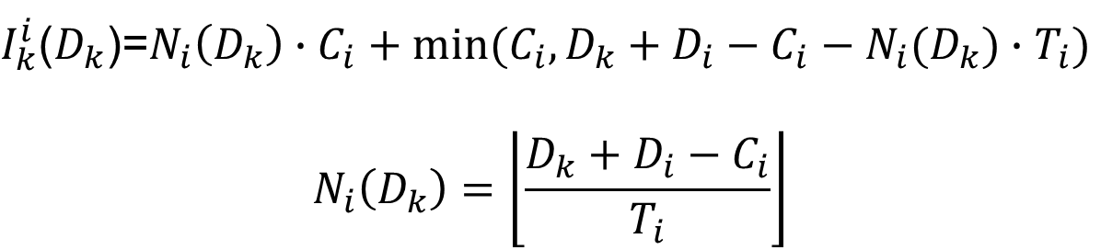
Schedulaiblity Analysis for Global Scheduling on Multiprocessor
The worst-case release pattern of τ_{i} maximizing $I_{k}^{i}\left(D_{k}\right)$
$I_{k}^{i}$($D_{k}$)=$N_{i}\left(D_{k}\right)∙C_{i}+min⁡(C_{i},D_{k}+D_{i}−C_{i}−N_{i}(D_{k})∙T_{i})$
$$N_{i}\left(D_{k}\right)=\left\lfloor \frac{D_{k}+D_{i}−C_{i}}{T_{i}}\right\rfloor$$
job release/deadline
execution
D_{k}
T_{i}
C_{i}
D_{i}

Slide 17
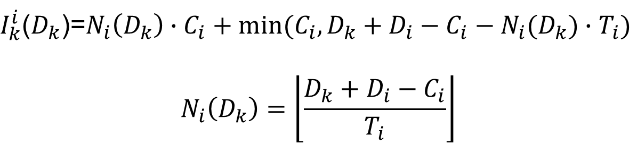
Schedulaiblity Analysis for Global Scheduling on Multiprocessor
Deadline-Based Analysis (DA analysis) – base idea
τ_{k} is schedulable under any global scheduling if
$$C_{k}+\left\lfloor \frac{1}{m}\sum_{k≠i}{I_{k}^{i}(D_{k})} \right\rfloor \text{≤} D_{k}$$
$I_{k}^{i}$($D_{k}$)=$N_{i}\left(D_{k}\right)∙C_{i}+min⁡(C_{i},D_{k}+D_{i}−C_{i}−N_{i}(D_{k})∙T_{i})$
$$N_{i}\left(D_{k}\right)=\left\lfloor \frac{D_{k}+D_{i}−C_{i}}{T_{i}}\right\rfloor$$

